Slide 1


Surgical Errors
Dr. Siddharth Rao
Additional Prof, General Surgery
AIIMS Bibinagar

Slide 2
Definition
Act of either omission or commission
Not achieving intended outcome
Error of execution
Error of planning
Deviation from standard of care

Slide 3
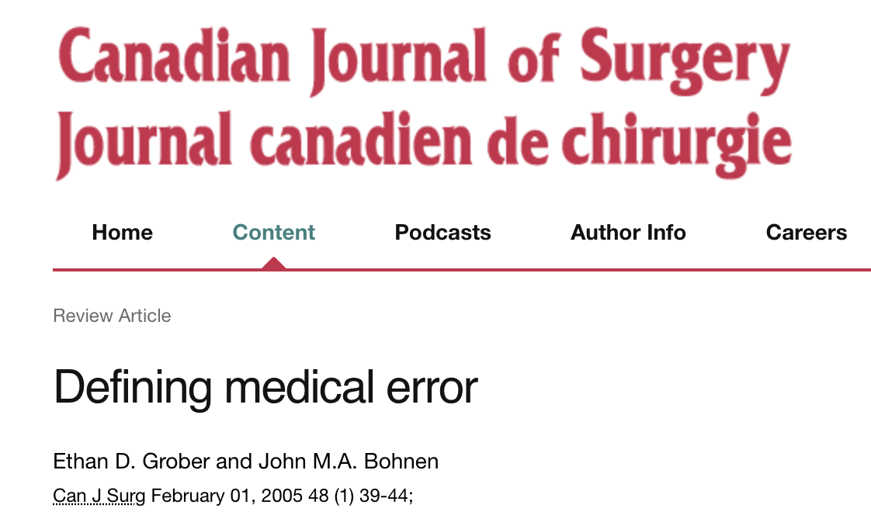
….medical errors as a failure in care that may or may not result in patient harm

Slide 4
Terminology
Adverse event
Patient injury resulting in disability or prolonged hospitalization caused by medical or surgical management rather than the patient’s underlying condition
Near miss event
A medical error that could have resulted in patient harm but did not due to intervention or chance is identified as a near miss.
Never event
These are medical errors that should never happen (eg, wrong patient/ wrong site surgery/ retained mops etc)

Slide 5
Terminology
Sentinel event
It is any unexpected adverse event "involving death, serious physical or psychological injury, or the risk thereof. The phrase 'or the risk thereof' includes any process variation for which a recurrence would carry a significant chance of a serious adverse outcome”.

Slide 6
Terminology
Wrong-site surgery
Wrong-patient surgery: surgical procedure performed on a different patient than the one intended to receive the operation.
Wrong-side surgery: indicates a surgical procedure performed on the wrong extremity or side of the patient’s body
Wrong-level / wrong-part surgery: surgical procedures that are performed at the correct operative site, but at the wrong level or part of the operative field or patient’s anatomy.

Slide 7
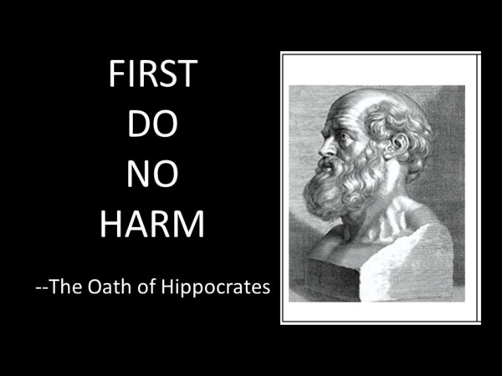

Slide 8
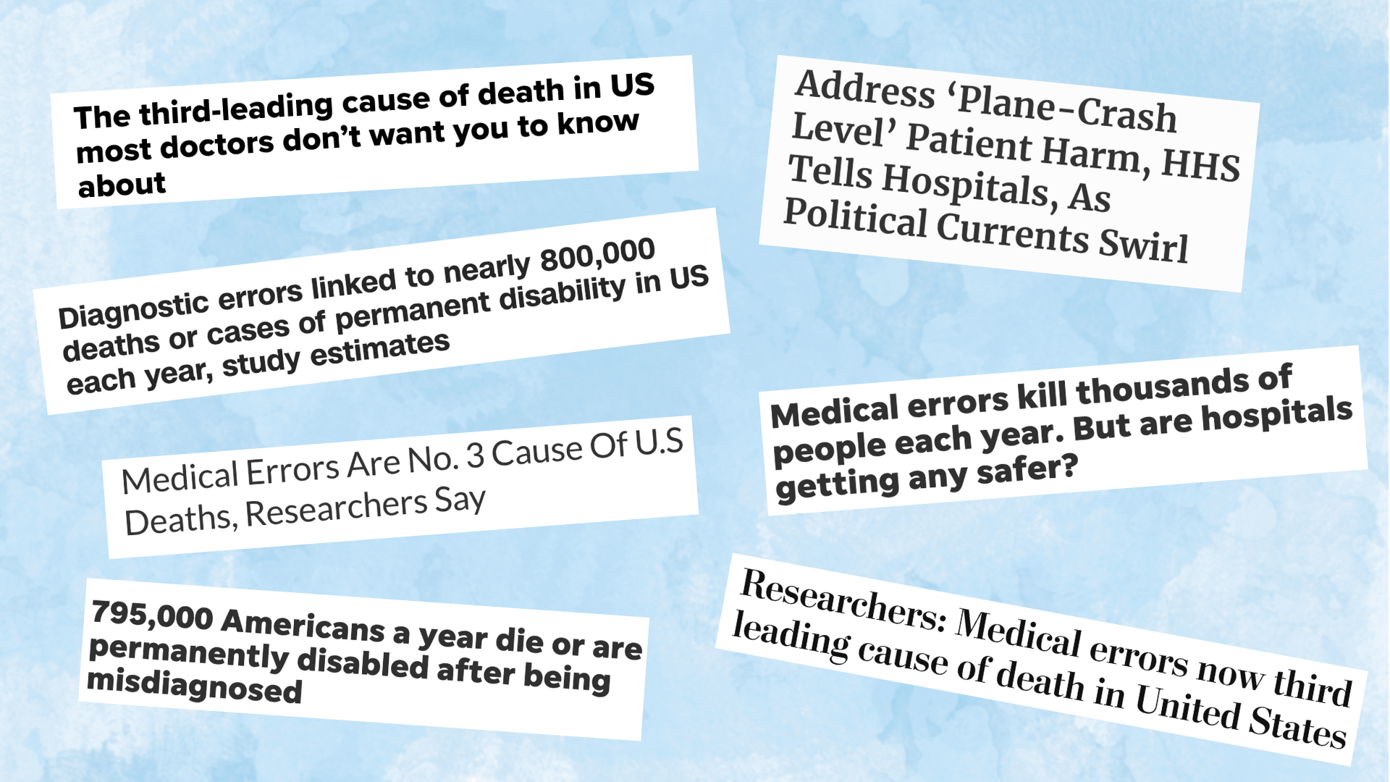

Slide 9
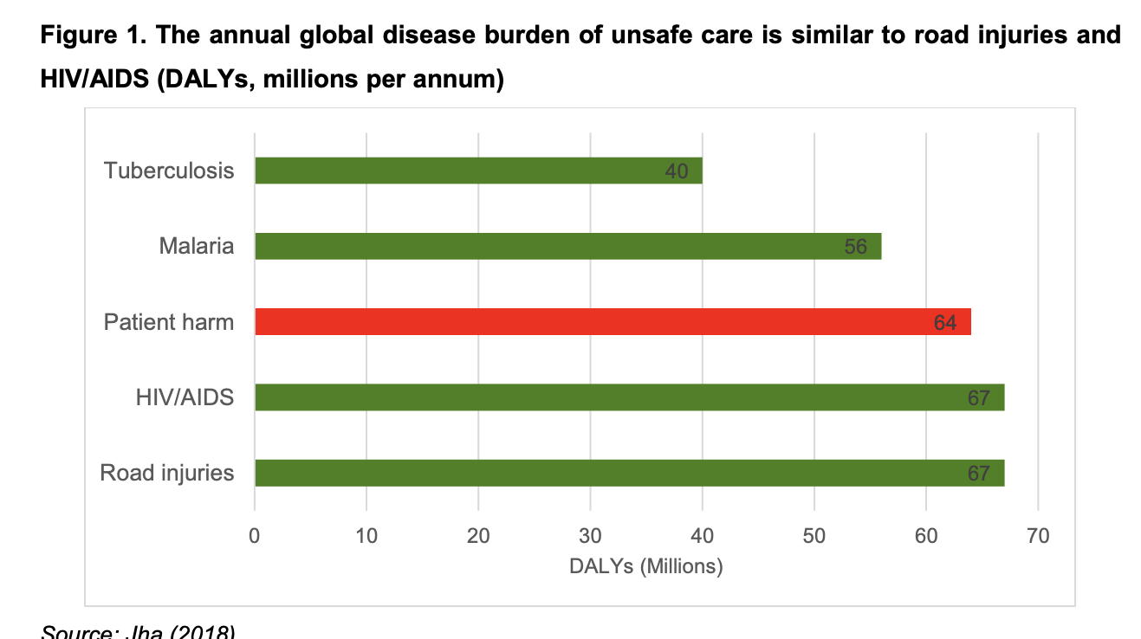
Why patient safety?
5.2 million injuries occur due to medical errors
Resulting in around 3 million preventable deaths every year
For every 100 Hospitalization average 12.7 adverse events occurs
One in 10 patients is subject to an adverse event while receiving hospital care
in high-income countries
Available evidence suggests that 134 million adverse events due to unsafe
care occur in hospitals in low- and middle-income countries, contributing to
around 2.6 million deaths every year

Slide 10
Around 1 in every 10 patients is harmed in health care and more than 3 million deaths occur annually due to unsafe care
In low-to-middle income countries, as many as 4 in 100 people die from unsafe care
Slawomirski L, Klazinga N. The economics of patient safety: from analysis to action. Paris:
Organisation for Economic Co-operation and Development; 2020
(http://www.oecd.org/health/health-systems/Economics-of-Patient-Safety-October-2020.pdf,
accessed 6 September 2023).

Slide 11
Above 50% of harm (1 in every 20 patients) is preventable; half of this harm is attributed to medications
Some estimates suggest that as many as 4 in 10 patients are harmed in primary and ambulatory settings, while up to 80% (23.6–85%) of this harm can be avoided
Panagioti M, Khan K, Keers RN, Abuzour A, Phipps D, Kontopantelis E et al. Prevalence, severity, and nature of preventable patient harm
across medical care settings: systematic review and meta-analysis. BMJ. 2019;366:l4185. doi:10.1136/bmj.l4185.
Hodkinson A, Tyler N, Ashcroft DM, Keers RN, Khan K, Phipps D et al. Preventable medication harm across health care settings:
a systematic review and meta-analysis. BMC Med. 2020;18(1):1–3.
Slawomirski L, Auraaen A, Klazinga N. The economics of patient safety in primary and ambulatory care: flying blind.
OECD Health Working Papers No. 106. Paris: Organisation for Economic Co-operation and Development; 2018
(https://doi.org/10.1787/baf425ad-en, accessed 6 September 2023).

Slide 12
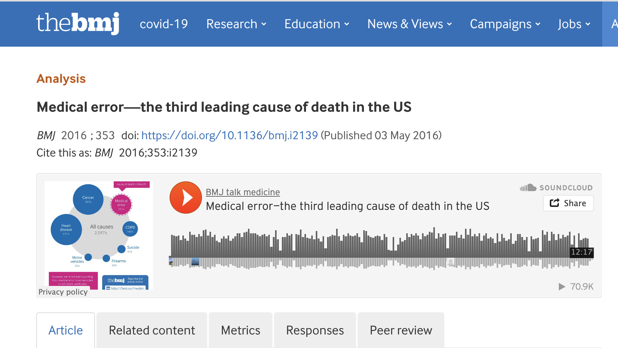
As many as 250,000 deaths per year in the United States were caused by
medical error
This was a sharp increase from the first major report on error-related deaths.

Slide 13
Scope of the problem- WHO Data
Around 1 in every 10 patients is harmed in health care and more than 3 million deaths occur annually due to unsafe care.
In low-to-middle income countries, as many as 4 in 100 people die from unsafe care

Slide 14
Scope of the problem
Institute of Medicine report in 1999
Incidence of 44,000 to 98,000 deaths annually

Slide 15
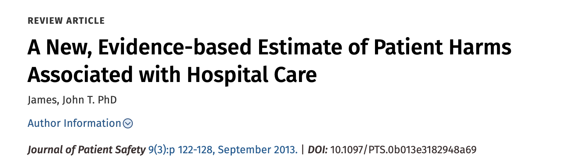
Scope of the problem

Slide 16
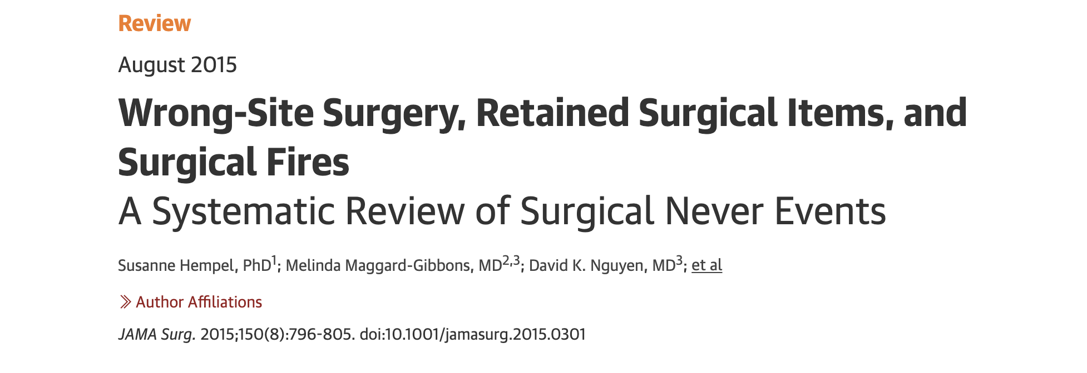
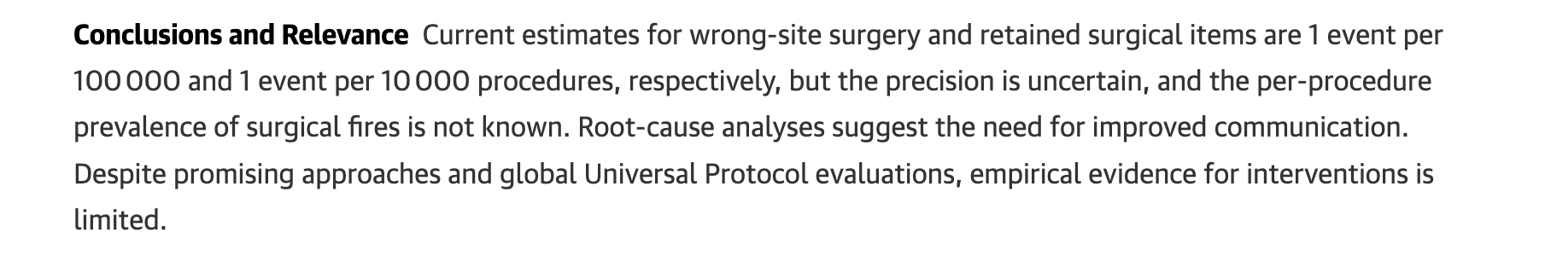

Slide 17
Pre-Op errors
Wrong patient
Wrong side
Wrong level/part
Wrong consent from patient

Slide 18
Post- Op errors
Retained Foreign Body
Wrong specimen labelling
Lost specimen
Wrong notes
Post operative instructions

Slide 19
Risk factors
Multiple surgeons involved in the case
Multiple procedures during a single surgical visit
Unusual time pressures to start or complete the procedure
Unusual physical characteristics, including morbid obesity or physical deformity

Slide 20
Challenges/Barriers for decreasing surgical errors
Traditional surgical culture in OR
Safety culture of the Organization
Poor teamwork and Communication
Lack of awareness

Slide 21
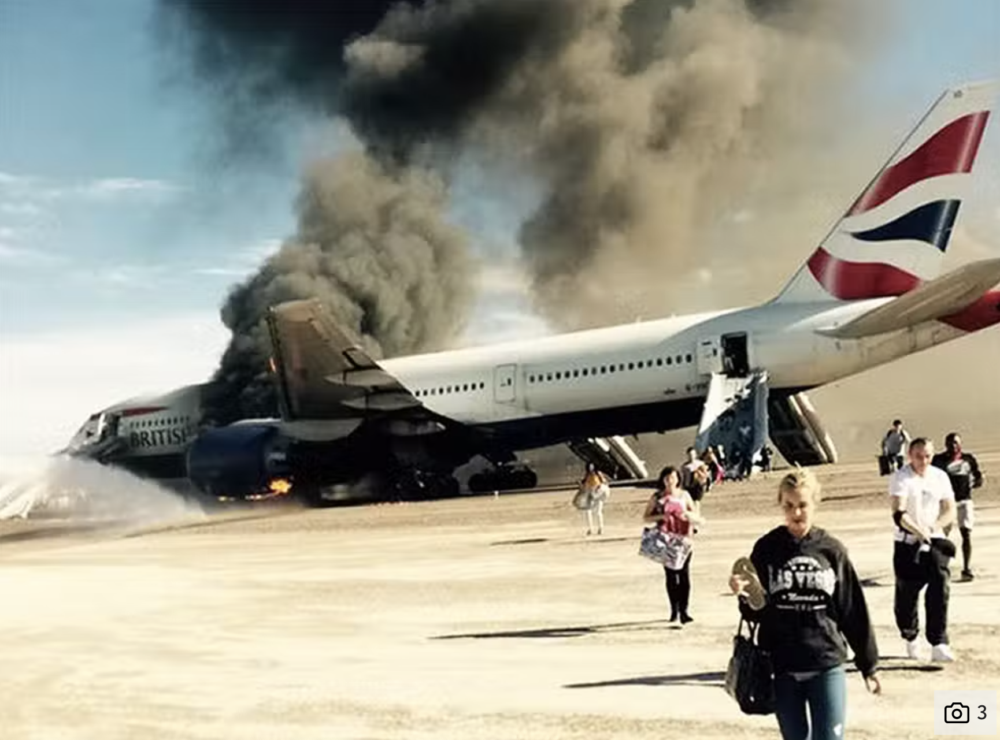
Commercial air transport is the safest form of travel today

Slide 22
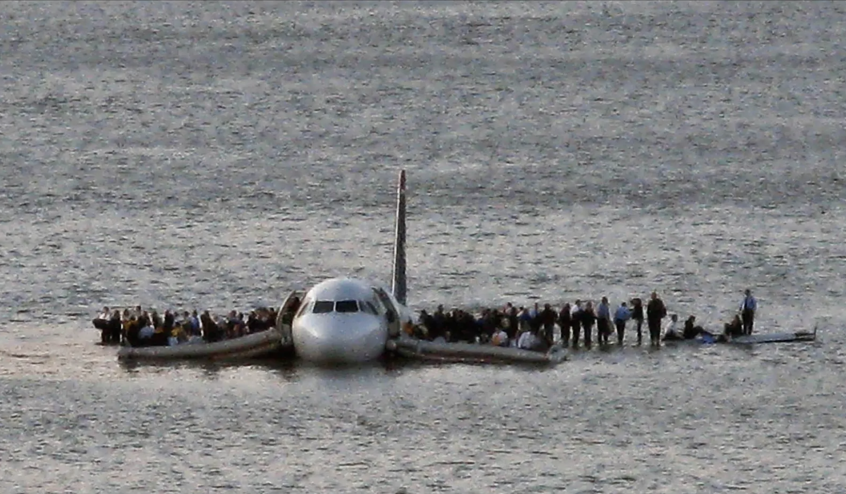
January 15th 2009 , Miracle on Hudson

Slide 23
THE SCIENCE OF PATIENT SAFETY
Lessons to learn from Aviation industry and Nuclear Submarine programs
Individual ownership
Responsibility
Attention to detail
Professionalism
Moral integrity
Mutual respect

Slide 24
Applying aviation industry principles to health care
Safety culture
“Blame free” organizational culture
Open 2-way communication
Processes and procedures
Task checklists
Flow and hand over checklists
Behaviors
Crew resource management
Open 2 – way Communication
Teamwork
Leadership
No fear of “speaking out”
Employee involvement – ownership
Employee well being
Equipment checklists
Communication at every stage of procedure
Debriefing
Training
Situational awareness
Shared Decision making
Cross checks and read back
Readiness to report and documentation of near – misses
Pride, self –esteem - decreased reporting

Slide 25
CREATING A CULTURE OF SAFETY
An acknowledgment of the high-risk, error-prone nature of an
Organization’s activities
No fear of punishment or retaliation for reporting errors
Collaboration across ranks
A willingness to direct resources to address safety concerns
Use of Safety Attitudes Questionnaire (SAQ)

Slide 26
COMMUNICATION TOOLS
Operating room briefing
Operating room de-briefing
Sign outs

Slide 27
COMMUNICATION TOOLS
Operating Room Briefings (Surgical Checklist):
Facilitate transfer of information between team members
Pre-procedure discussion of requirements, needs, and special issues of the procedure
Locally adapted to the specific needs of the specialty
Associated with improved safety culture

Slide 28
COMMUNICATION TOOLS
Operating Room de-briefings:
Errors or critical incidents are regarded as learning opportunities
Discuss the teams performance during the surgery
Designate a point person for follow up
Check mop/instrument/needle counts
Check proper labelling and orientation of the specimen

Slide 29
COMMUNICATION TOOLS
Sign outs:
Written communication between teams of doctors
Change in patient’s care setting or provider
Tend to be variable, unstructured, and prone to error
SBAR (situation, background, assessment, and recommendation)

Slide 30
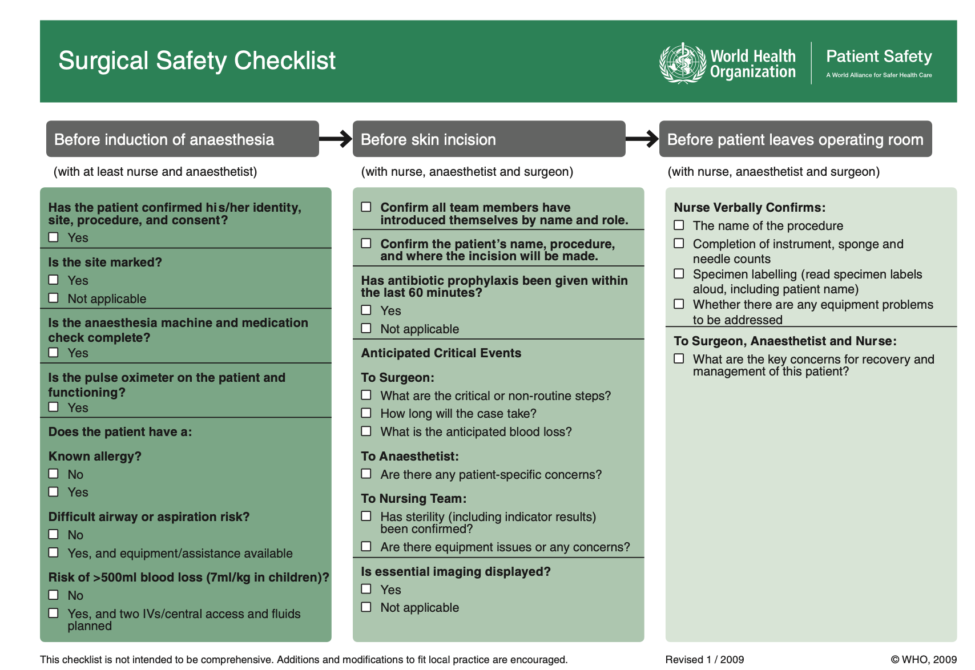

Slide 31
Error prevention in Surgical training
Emphasis on surgical skills and decision making
Faculty need to balance resident autonomy and patient safety
Use of High-Fidelity simulators

Slide 32
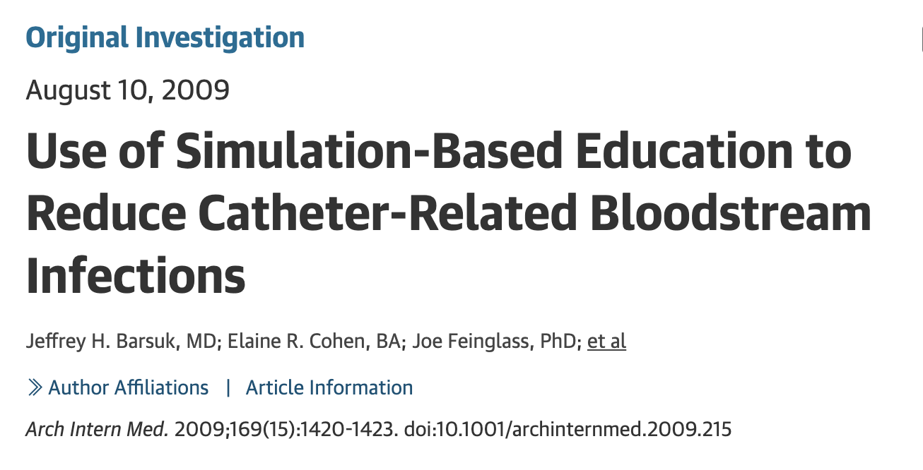
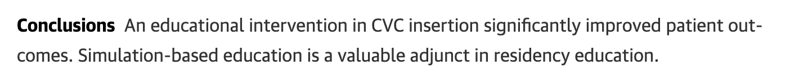

Slide 33
“All men make mistakes, but a good man yields when he knows his course is wrong and repairs the evil . The only crime is PRIDE.”
-Sophocles, Antigone

Slide 34
SAFETY CHECKS
Check list
CRM
Human Factor Analysis and Classification System

Slide 35
Key take home messages
Surgeons are humans
Patient care before own ego
Learn to work as a team
Fearless working environment
Communication, communication ,communication, communication

Slide 36

Thank you!

